Slide 1
ABGSC Oncology Seminar
November 2021

Slide 2
Forward-looking statement
This announcement and any materials distributed in connection with this presentation may contain certain forward-looking statements. By their nature, forward-looking statements involve risk and uncertainty because they reflect the company’s current expectations and assumptions as to future events and circumstances that may not prove accurate.
A number of material factors could cause actual results and developments to differ materially from those expressed or implied by these forward-looking statements.

Slide 3
Nykode Therapeutics enters into multi-target license and collaboration agreement with Regeneron to develop innovative vaccines against cancer and infectious diseases

Slide 4
Vaccibody becomes Nykode Therapeutics

Slide 5
Overview of Nykode
Leading immune therapy platform allowing rapid development of new drug candidates addressing a broad range of diseases with significant unmet need
Rapidly advancing oncology portfolio, including wholly-owned “off-the-shelf” cancer vaccines against HPV driven cancer types, currently in phase 2
Significant potential to apply platform in the infectious disease space, as evidenced by next generation COVID vaccines with potential to address limitations associated with current vaccines
Validating collaborations with partners of choice including Roche/Genentech, Adaptive Biotechnologies and Regeneron
Solid strategy to exploit platform into new therapeutic areas such as autoimmune diseases
Well capitalized and multiple significant catalysts in near-to-medium term
Highly experienced management team with proven successful track record

Slide 6
Regeneron – Nykode Therapeutics collaboration overview Discovery, development and commercialization of 5 novel vaccine programs
Multi-target license and collaboration agreement with Regeneron to develop novel and innovative vaccines against cancer and infectious diseases
Responsible for vaccine generation and characterization, as well as product supply through phase 1 trials
Responsible for antigen identification, preclinical and clinical development, manufacturing (after phase 1 trials) and commercialization
IN SUMMARY
3 oncology and 2 novel infectious disease programs, each may include several candidates
Regeneron to cover all research, development and commercialization costs
Upfront of USD 30 million and USD 20 million equity investment at 20% premium
Potential milestone payments of more than USD 875 million
Tiered high single-digit to low double-digit royalties on net sales

Slide 7
Pipeline
Broad oncology coverage and strong partnerships. Leveraging platform within infectious diseases
Program | Indication | Discovery/Preclinical | Phase 1 | Phase 2 | Phase 3 | Partnerships | Upcoming Milestones
Oncology
Off the shelf
VB10.16 | HPV16+ cervical cancer³ |  |  |  |  |  | 2H21: Trial Fully Enrolled 1H22: Interim Data
Regeneron program 1 | Undisclosed |  |  |  |  | Regeneron⁵
Regeneron program 2 | Undisclosed |  |  |  |  | Regeneron⁵
Regeneron program 3 | Undisclosed |  |  |  |  | Regeneron⁵
Internal programs | Undisclosed targets within shared antigens
Individualized
VB10.NEO | Melanoma, lung, bladder, renal, head and neck |  |  |  |  | Genentech¹ Nektar Therapeutics ²
VB10.NEO | Locally advanced and metastatic tumors |  |  |  |  | Genentech ¹
Infectious disease
VB10.COV2 | SARS-CoV-2 |  |  |  |  | Adaptive Biotechnologies⁴ | 1H22: Interim data
Regeneron program 4 | Undisclosed |  |  |  |  | Regeneron⁵
Regeneron program 5 | Undisclosed |  |  |  |  | Regeneron⁵
Internal programs | Undisclosed targets within infectious disease
1. Genentech has an exclusive license to VB10.NEO; 2. Collaboration with Nektar Therapeutics on combining NKTR-214 (bempegaldesleukin) with VB10.NEO in trial arm 5B (SCCHN); 3..Roche supplies atezolizumab; 4. Collaboration with Adaptive Biotechnologies on SARS-CoV-2 T cell vaccine; 5. Collaboration with Regeneron

Slide 8
Regeneron is a partner of choice for Nykode Therapeutics
Deep scientific expertise and successful track record
REGENERON OVERVIEW
10,000+ employees
Scientifically led and focused on innovative drug development
Brings unique insights on antigen selection for the collaboration programs
Proven track record within oncology and infectious disease
9 FDA approved drugs
Excellent cultural fit

Slide 9
Perfect fit with Nykode Therapeutics growth strategy
Validates our unique therapeutic vaccine platform
Expands and fast tracks our pipeline into novel and innovative areas across oncology and infectious diseases
Fully complementary to current and future pipeline
Cash flow allows us to accelerate platform and pipeline development within and beyond vaccines

Slide 10
Flexible Vaccibody platform can fuel multiple, precise products customized for each indication
The Vaccibody technology platform is developed based on the concept of targeting antigen to Antigen Presenting Cells (APCs) in order to create more efficacious vaccines.
We have achieved this by combining selected genes to encode novel vaccine molecules with desired properties
APC targeted vaccine platform
APC targeted vaccine platform
The Vaccibody platform is agnostic in terms of delivery format:
DNA vaccine
mRNA vaccine
Viral vector vaccine
Fusion protein subunit vaccine
Targeting unit to attract and bind Antigen Presenting Cell
Dimerization unit for crosslinking targeted receptor
Antigenic unit
The Vaccibody platform allows for flexibility both within the molecule and through the mode of delivery Vaccibody is very well tolerated and provides large potential for combination therapies Applicable to develop specific vaccine products for cancer, infectious diseases and autoimmunity

Slide 11
Vaccibody mechanism of action
The APC targeting vaccine technology platform creates unique rapid, strong and broad immune responses that can be tailored to each disease.
mechanism of action

Slide 12
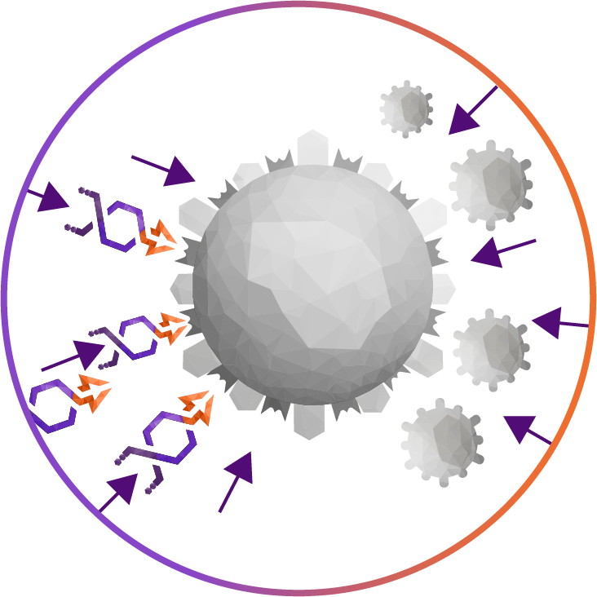
Targeting unit offers unique ability to explore Ag-specific immune tolerance
Cancer and infectious disease
Autoimmunity, allergy etc
Stimulatory
DC
Tolerogenic
DC
Natural ligands or scFv binding diverse set of surface receptors
IL-12, IFNγ, TNFα, IFNα, IL-6
IL-10, TGFβ, IDO, PD-1, ARG
T_{H} 1, T_{H}, 17, T_{H}2
differentiation and
proliferation
Treg and or Tr1 arrest or impaired function
CD4+, CD8+
conventional T cells proliferation arrest
Treg and or Tr1
generation

Slide 13
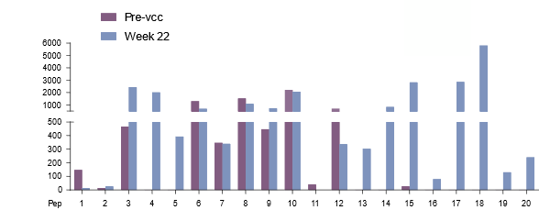
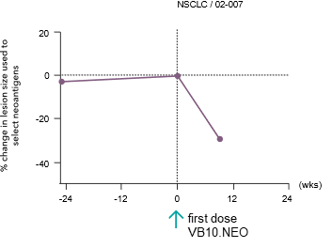
VB10.NEO: Fully individualized neoantigen based cancer vaccine
Finalized enrollment VB N-01; 5 indications, <50 pt
Landmark deal with partner of choice Genentech (200m$ upfront & near term, 515m$ additional milestones and low double digit royalties)
Initiated VB N-02, in collaboration with Genentech; > 10 indications, 2 doses, combo with atezolizumab, ~40 patients
Demonstrated ability to raise broad and strong patient-by-patient neoantigen-specific immune responses
Correlation between vaccine-induced immune responses and clinical responses
Correlation with incorporation of high-quality neoepitopes
VB10.NEO data

Slide 14
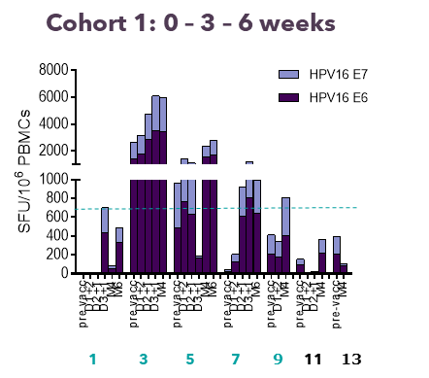
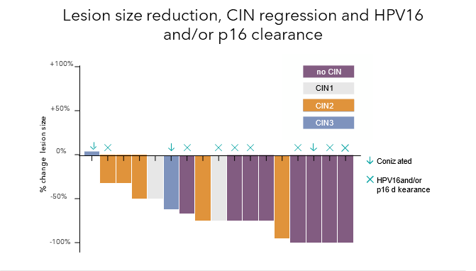
VB10.16: Off the shelf therapeutic HPV vaccine
Finalized Phase I/IIa study with VB10.16 monotherapy in HPV16+ precancerous cervical lesions
Demonstrated ability to induce strong HPV16 specific T cell responses
Strong correlation between vaccine induced T cell responses and lesion size reduction
Data from PD-L1 upregulation in monotherapy study provide scientific rationale for combination of anti-PD-1/PD-L1
Phase II study of VB10.16 + atezolizumab in advanced cervical cancer has been initiated and interim safety analysis support continuation release of interim clinical data expected Q1 2022
Potential to expand scope to several HPV driven cancer types, including head and neck cancer
Fully owned by Vaccibody
VB10.16 data

Slide 15
Signifying a new phase of growth and development
ENCAPSULATES VISION OF FINDING NEW WAYS OF CODING MEDICINES
Draws on our heritage by using the Norwegian words for the words new “ny” and code “kode”
Exploiting future potential building on our core competences
Significantly expanding our pipeline through internal and selected partnered programs
Building the organization with strong focus on continuous innovation
Extending our footprint into additional territories
Expanding into additional therapeutic areas and therapeutic modalities, also outside vaccines

Slide 16
Strong financial foundation for achieving our vision
Very strong foundation and solid fundamentals for our business
Total available liquidity of USD188.9 million on September 30, 2021
Cash and cash equivalents of USD 172,6 million
Liquid money market funds of USD 16.3 million
Financially well positioned to grow and execute the Company’s strategy over the next years
Nykode has initiated a process to explore a possible listing on the Nasdaq (US)
Nykode Therapeutics |

Slide 17
Key investment highlights
Unique, leading and proprietary vaccine platform with potential to fuel future pipeline across multiple diseases
Validated through clinical data and collaborations with partners of choice
Solid oncology pipeline addressing broad range of tumor types as well as novel next-generation Covid-19 vaccine candidates
Key catalysts within next 12 months
Well capitalized to execute growth strategy and maximize value generation

Slide 18
Back up
Contact
Michael Engsig CEO
IR@vaccibody.com

Slide 19
Key strengths of Nykode infectious disease platform
Rapid onset of immunogenicity
Vaccine platform enabling complex and multiple antigen design
Attractive manufacturing, formulation and administration
Tailored to each disease’s correlate of protection
Well-tolerated

Slide 20
Nykode platform has potential to generate leading next generation COVID vaccine
Focus on Variants of Concern
Increasing evidence that neutralizing antibodies induced by the marketed Wuhan based vaccines wane over time
Further reduced efficacy against Variants of concern (VoC)
Both of Nykode’s COVID candidates are engineered to provide longer-lasting and superior protection against these emerging variants vs. existing COVID vaccines
Broad Based T-Cell Response
Increasing evidence of the importance of broad T cell responses against COVID-19
T cell response in vaccinated human subjects coincide with early protection and a higher proportion of CD8+ T cell responses is observed in mild disease
Current vaccine approaches tend to not generate broad based immune responses
Nykode’s VB10.2210 candidate takes advantage of T cell epitopes identified by Adaptive Biotechnologies to generate rapid onset of broad T-cell immunity
In addition to their significant protective benefits against COVID, Nykode’s COVID candidates represent an
opportunity to move assets rapidly through the clinic and validate the Nykode’s infectious disease approach

Slide 21
Adaptive is the partner of choice for T cell based Covid-19 vaccines
Sequenced TCRs and identified expanded COVID-19 specific T cell clones in more than 6500 samples from COVID-19 patients.
Mapped the TCRs to corresponding T cell epitopes, including cell-based assays.
Optimal combination of conserved and immuno-dominant T-cell epitope hotspots across all 8 SARS-CoV-2 antigens were subsequently used for vaccine design.
Adaptive launched T-Detect™ COVID, which is the first-in-class T-cell-based clinical test for Covid-19 with FDA Emergency Use Authorization.
To be implemented also for immunomonitoring.

Slide 22
Nykode’s SARS-CoV-2 vaccines
Nykode is currently advancing two COVID-19 vaccine candidates with different approaches, and potential to be used in combination
VB10.2129 – RBD candidate
VB10.2210 – T cell candidate
RBD vaccine tailored to the B1.351 (Beta) VoC to generate cross-neutralizing RBD-specific antibody and T cell immunity
T-cell epitope vaccine inducing broadly protective T cell responses
Targeting unit
Targeting unit
Dimerization unit
Dimerization unit
Antigen unit
B1.351 VoC RBD
K417N, E484K and N501Y mutations
Antigen unit
Validated T cell epitopes identified by Adaptive Biotechnologies

Slide 23
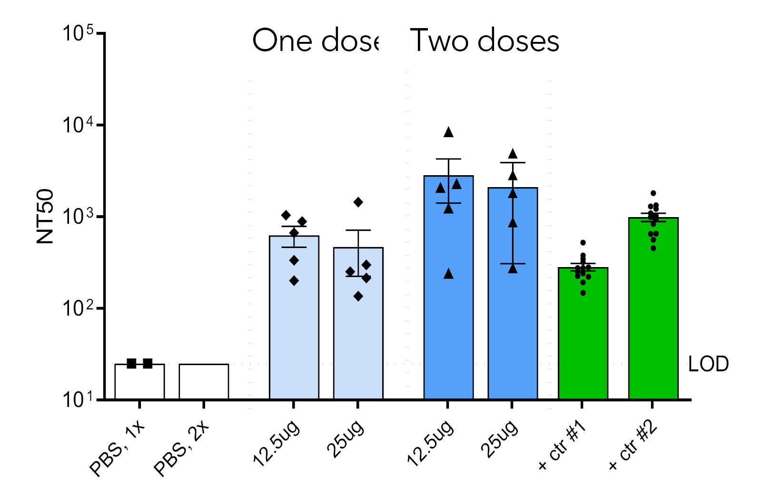
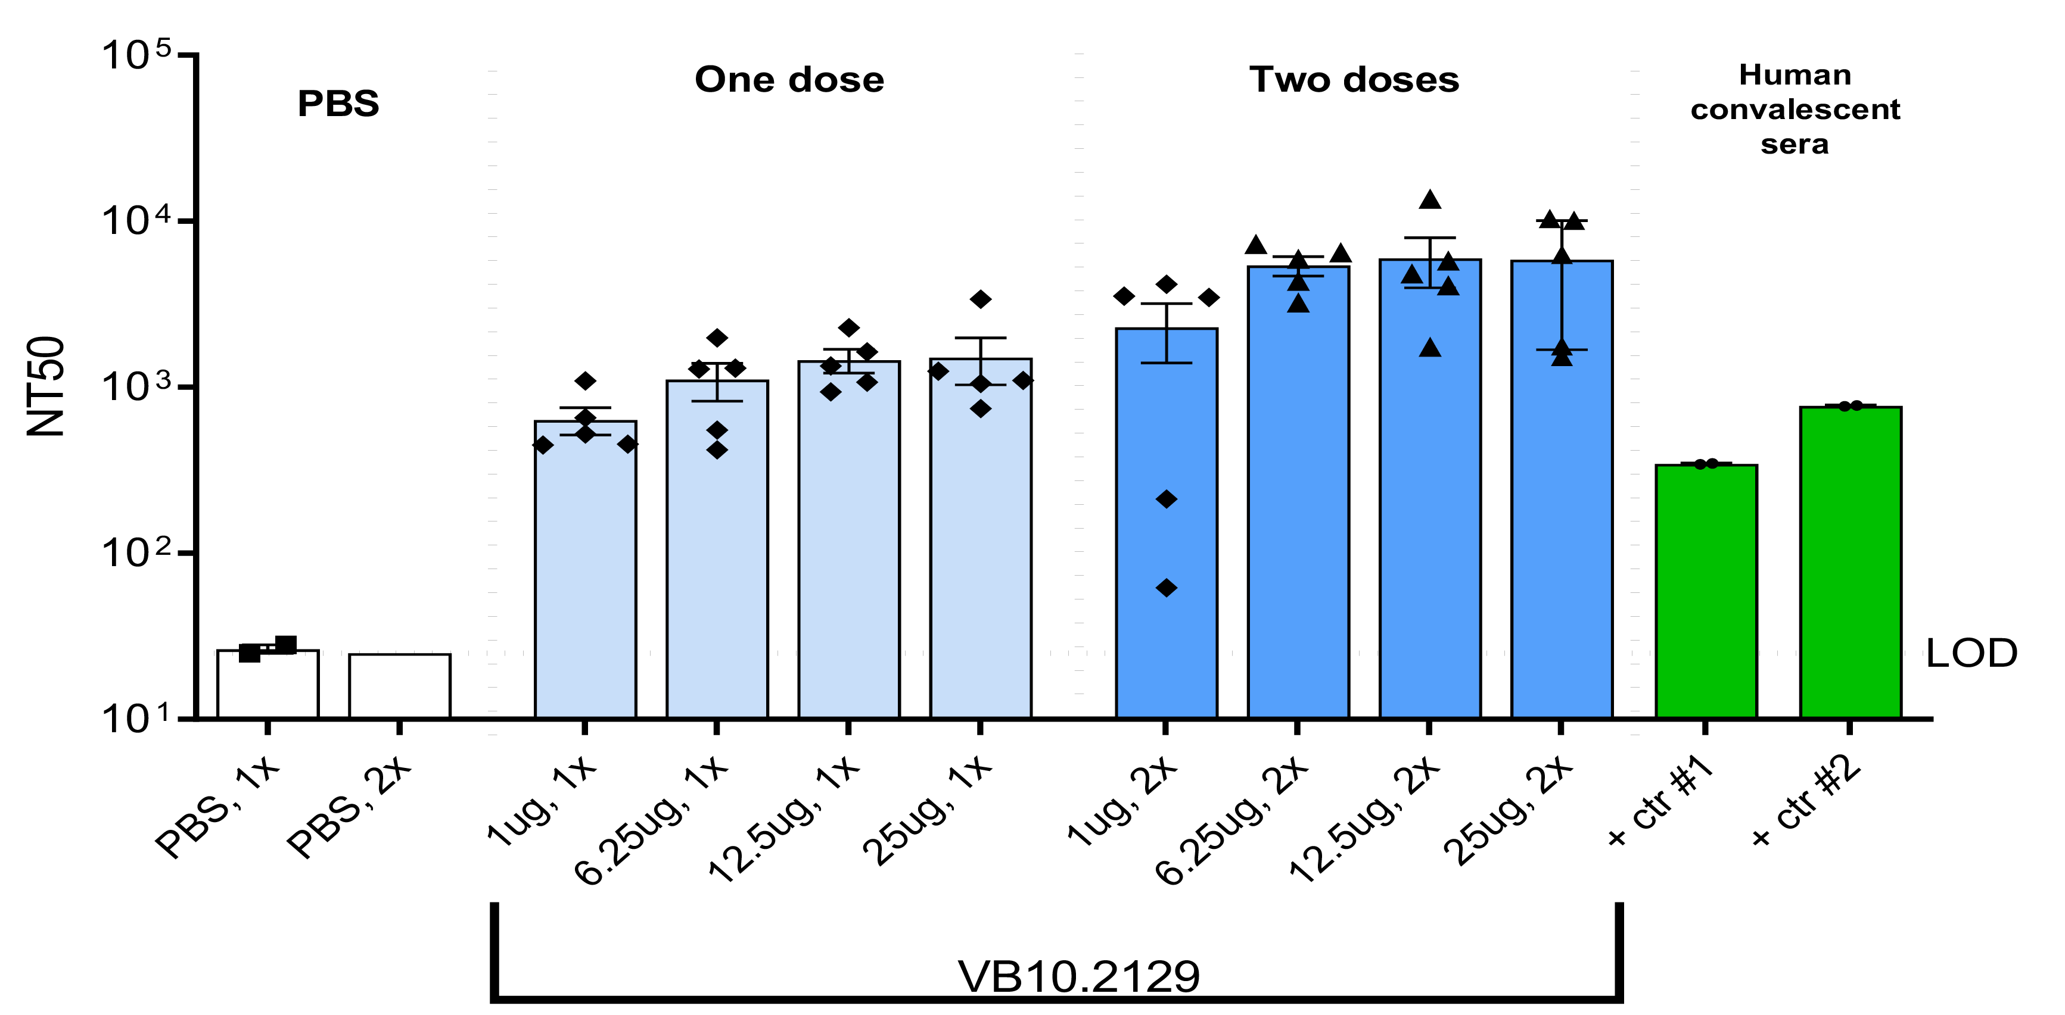
RBD candidate VB10.2129 induces potent virus neutralization responses across VoC
Beta – South African VoC (Pseudovirus neutralization assay)
Wuhan (Original strain)
Alpha (UK VoC)
Gamma (Brazilian VoC)
Rapid onset of strong neutralizing antibody responses after a single vaccination
Cross-neutralization observed against all other variants tested
Human convalescent sera
NT50: Neutralization titers that achieved 50% neutralization

Slide 24
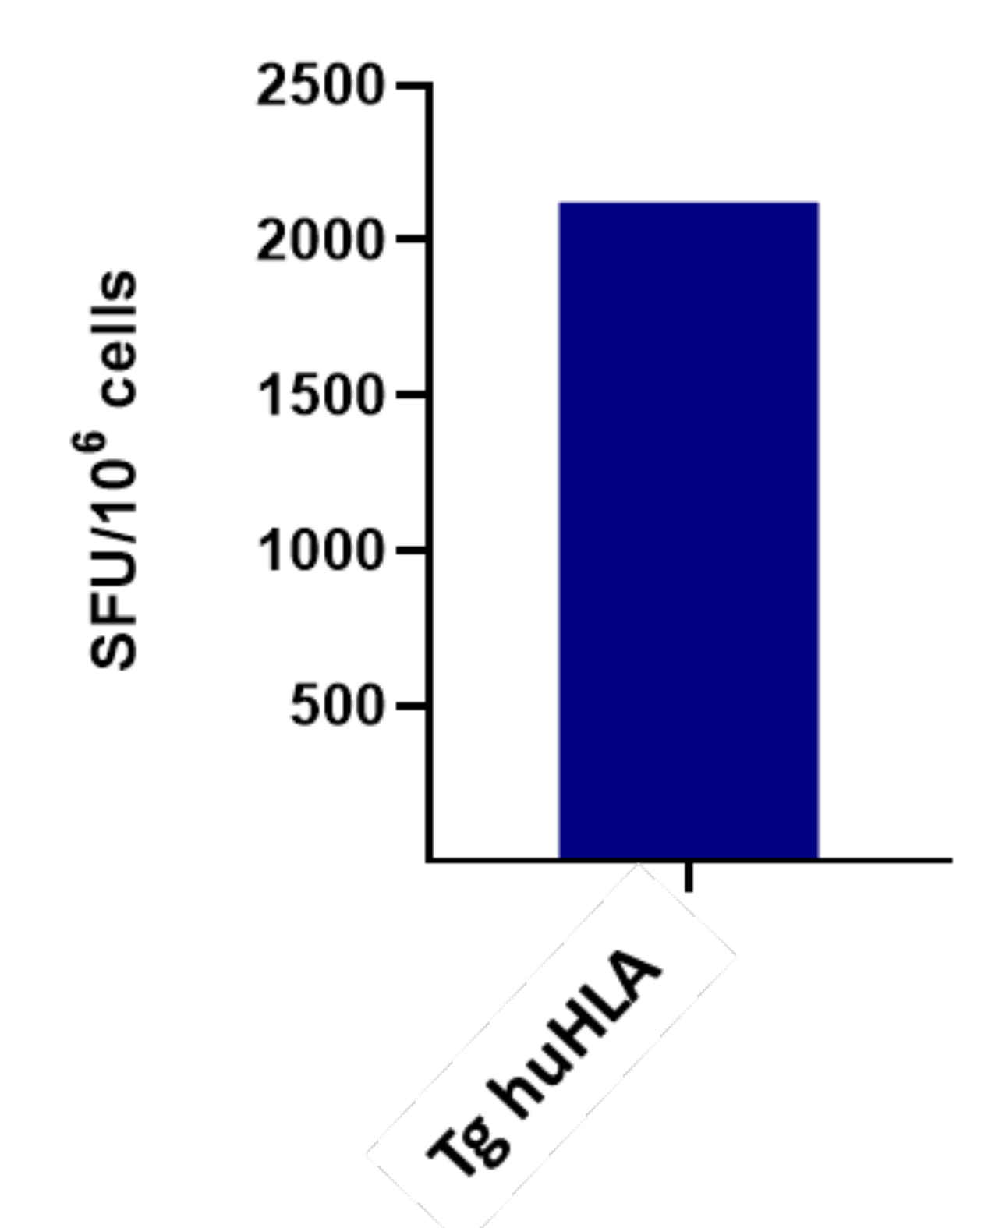
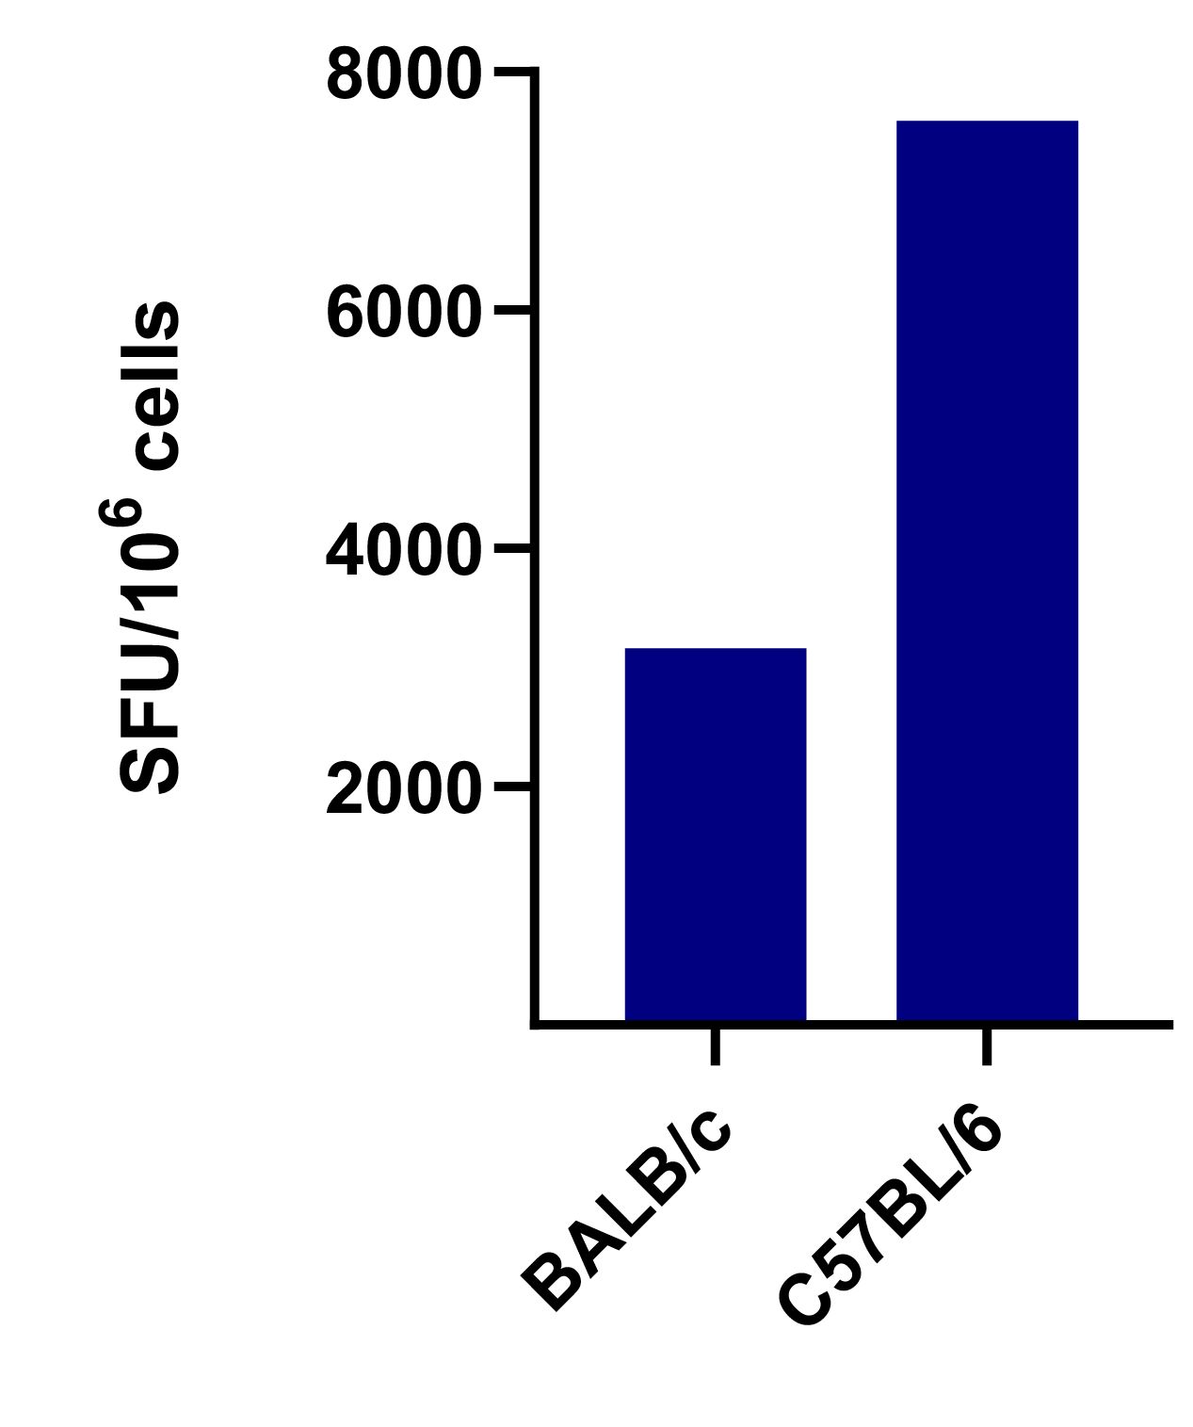
Strong immunogenicity of VB10.2210 in 3 mouse models
VB10.2210 induces strong CD8 T cell responses post 1 vaccination against HLA-A2 specific epitopes in humanized HLA-A2 tg mice
The strong T cell responses observed in two additional mice models show the breadth of the T cell response independent of HLA selection
Tg HLA-A2 BALB/c C57BL/6
Animals Transgenic mice expressing human HLA-A2
Dose 50 µg
Recall peptides Pools only for HLA-A2 restricted epitopes
Animals C57BL/6 and BALB/c wt
Dose 25 µg
Recall peptides Pools overlapping all the epitopes included in the construct
Tg HLA-A2

Slide 25
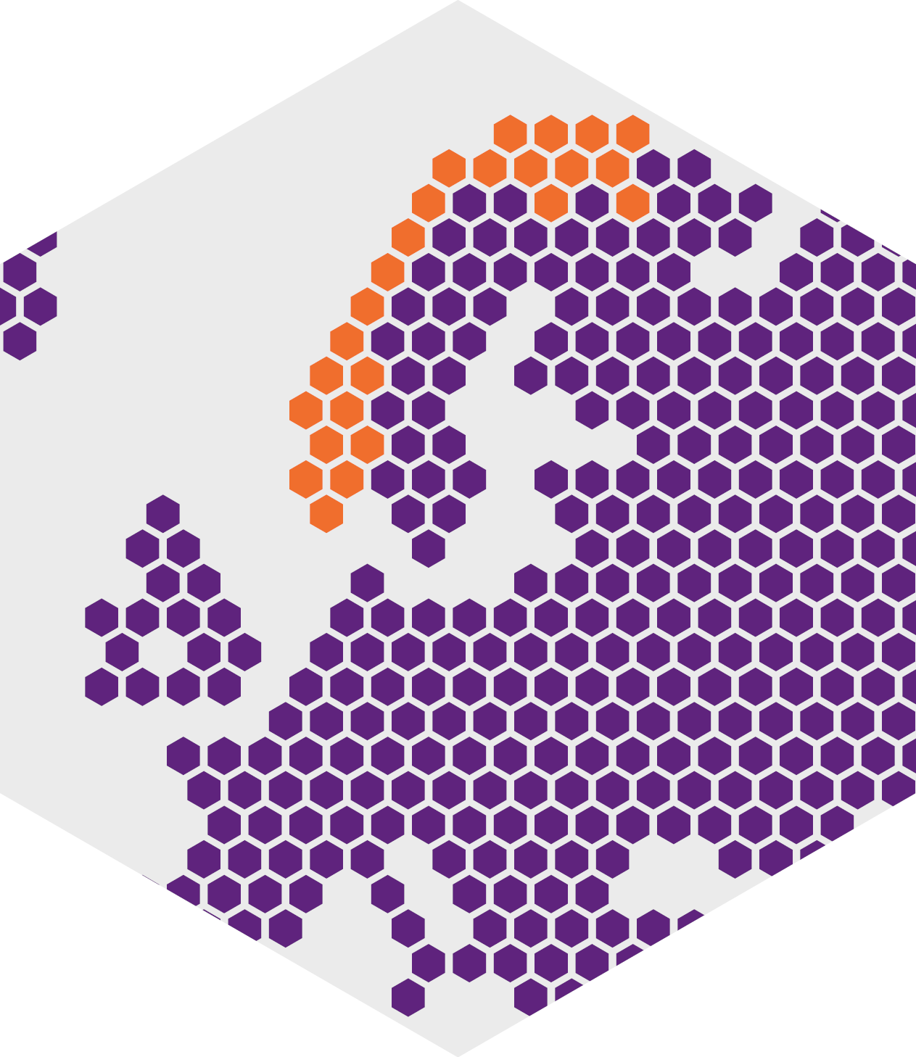
VB-D-01 investigating two candidates as a booster in previously vaccinated subjects
A Phase 1/2, open label, dose escalation trial
First subject dosed Nov 3rd
Up to 160 subjects are planned to participate
VB-D-01 Trial design
«RBD» Candidate
Candidate 1: Healthy volunteers
Cohort 1:
Cohort 2:
Dose escalation
Expansion
«T-Cell» Candidate
Candidate 2: Healthy volunteers
Cohort 3:
Cohort 4:
Dose escalation
Expansion

Slide 26
Thank you
Contact
Michael Engsig CEO
mengsig@nykode.com
+45 6173 1509

